Slide 1


KALLAM HARANADHAREDDY INSTITUTE OF TECHNOLOGY (Autonomous) Chowdavaram, Guntur Dt. Amaravathi , Andhra Pradesh Affiliated to jntuk , approved by aicte , New Delhi
Project review-2
0n
Amazon web services
&
Smart waste management system
Team Members :K. Vennela (218x1a0434)
K. Udaya Sri(218x1a0442)
K. Avinash(218x1a0432)
K.Murali Manohara joshi(218x1a0422)
Mentored By: Mr. K. Ravi kanth sir

Slide 2
CONTENTS
Introduction
Literature survey
Long Term Internship (AWS)
Project (Internet of Things)
Smart Waste Management System
Block Diagram
Github links
Advantages & Disadvantages
Conclusion
References

Slide 3
INTRODUCTION
The purpose of this paper is to gain an understanding of project management and to give a brief overview of the methodology that underpins most formally run projects. Many organisations do not employ full time Project Managers and it is common to pull together a project team to address a specific need.
While most people are not formally skilled in project methodology, taking a role in a project team can be an excellent learning opportunity and can enhance a person's career profile.
Generally, projects are split into three phases Initiation, Implementation and Closure. Each phase then has multiple checkpoints that must be met before the next phase begins. The degree to which a project is managed will depend on the size of the project.

Slide 4
LITERATURE SURVEY
A literature survey or a literature review in a project report is that section which shows the various analyses and research made in the field of your interest and the results already published, taking into account the various parameters of the project and the extent of the project.
It is the most important part of your report as it gives you a direction in the area of your research. It helps you set a goal for your analysis - thus giving you your problem statement.
When you write a literature review in respect of your project, you have to write the researches made by various analysts - their methodology (which is basically their abstract) and the conclusions they have arrived at. You should also give an account of how this research has influenced your thesis.

Slide 5


LONG TERM INTERNSHIP (AWS)
AWS stands for Amazon Web Services, a cloud computing platform that offers a variety of services. It's provided by Amazon and is available over the internet.
AWS pricing model
AWS uses a pay-as-per-use pricing model.
AWS services for businesses
AWS helps businesses grow by providing tools and services to host applications, store data, and manage IT resources.
AWS services for individuals
AWS also helps individuals host applications and store data securely.

Slide 6
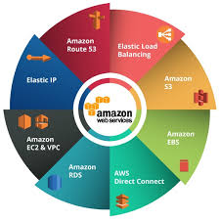
AWS SERVICES
Amazon Web Services (AWS) offers a variety of cloud-based services, including computing, storage, networking, database, and analytics.
Amazon route s3
Elastic load balancing
Amazon EBS
AWS Direct Connect
Amazon RDS
Amazon ECE & VPC
Elastic IP

Slide 7
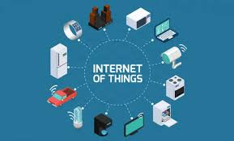
PROJECT DOMAIN: INTERNET OF THINGS
The Internet of Things (IoT) refers to a network of physical objects, or "things," embedded with sensors, software, and network connectivity, enabling them to collect and share data, facilitating communication between devices and systems over the internet.
IoT connects everyday objects to the internet, allowing them to collect, transmit, and act upon data.

Slide 8
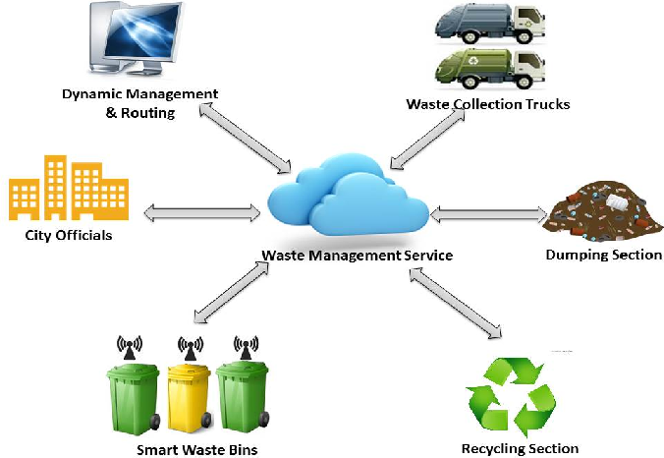
TITLE: SMART WASTE MANAGEMENT SYSTEM
Smart waste management systems leverage technology, like IoT and sensors, to optimize waste collection, transport, and disposal, making the process more efficient, sustainable, and cost-effective.
Key Technologies:
Internet of Things (IoT): Connects waste bins and vehicles to the internet, enabling real-time data collection and communication.
Sensors: Monitor bin fill levels, detect leaks, and provide other real-time data.
GPS: Tracks the location of waste collection vehicles and optimizes routes.
AI and Machine Learning: Analyze data to predict waste generation patterns, optimize collection schedules, and improve overall efficiency.

Slide 9
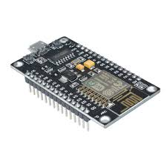
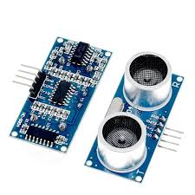
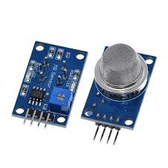
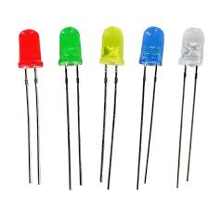
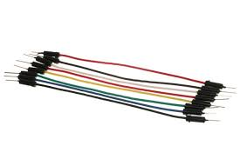
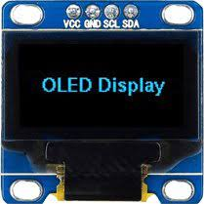
COMPONENTS
Nodemcu esp8266
ultrasonic sensor
mq135
jumper wires
Oled sensor
led

Slide 10
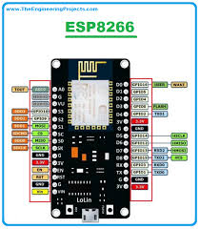
NODEMCU ESP8266
The "ESP" in ESP8266 stands for "Espressif", the Shanghai-based Chinese manufacturer of the low-cost Wi-Fi microchip.
The NodeMCU ESP8266 is a popular, low-cost, open-source development board and firmware based on the ESP8266 Wi-Fi chip, designed for creating Internet of Things (IoT) applications and easily programmable with Lua scripting or the Arduino IDE.

Slide 11
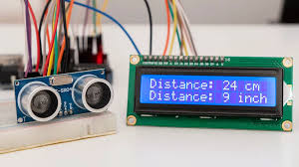
ULTRASONIC SENSOR
An ultrasonic sensor is an electronic device that uses high-frequency sound waves (ultrasound) to measure distance or detect objects, working by emitting sound pulses and measuring the time it takes for the reflected echoes to return.
Ultrasonic sensors work by sending out a sound wave at a frequency above the range of human hearing. The transducer of the sensor acts as a microphone to receive and send the ultrasonic sound.

Slide 12
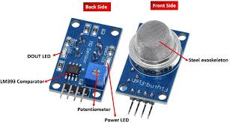
MQ 135
MQ135 gas sensor has high sensitivity to ammonia gas, sulfide, benzene series steam, also can monitor smoke and other toxic gases well. It can detect kinds of toxic gases and is a kind of low-cost sensor for kinds of applications.
MQ gas sensors are a family of sensors which are used to detect a wide variety of gases like alcohol, smoke, methane, LPG, hydrogen, NH3, Benzene, Propane etc. These sensors are made up of electrode which is coated with a sensing material, and it is heated to make it more reactive and sensitive.

Slide 13

OLED DISPLAY
The acronym ‘OLED’ stands for Organic Light-Emitting Diode. These devices use LED technology and use an organic material as a light emitting layer. Organic LEDs can produce high quality displays with high contrasts, high viewing angles and true blacks. Some say that OLEDs produce the world’s best display panels.
In OLED display screens, each pixel is controlled individually and emits its own light (unlike LCDs in which the light comes from a backlighting unit). This is known as an emissive display. OLED displays deliver great image quality - bright colors, fast motion and most importantly - very high contrast.

Slide 14
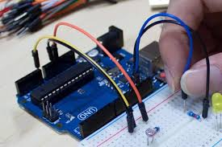
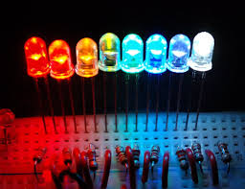
JUMPER WIRES & LED
Jumper wires are short, conductive wires with connectors or pins at each end, used to make temporary connections between components in circuits, breadboards, or other prototyping setups, without the need for soldering.
A light-emitting diode (LED) is a semiconductor device that emits light when an electric current flows through it, a process called electroluminescence.

Slide 15
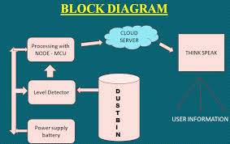

Slide 16
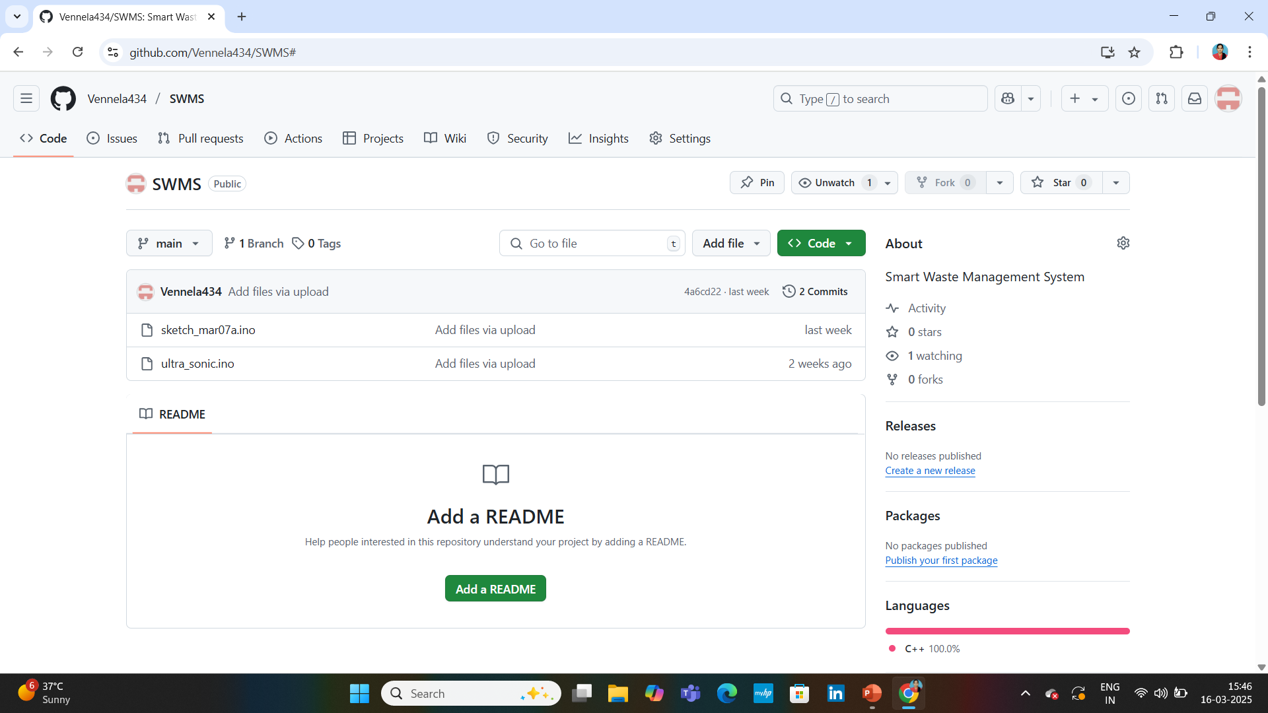
GITHUB LINK: https://github.com/Vennela434/SWMS.git CODE OF THE PROJECT LINK : gh repo clone Vennela434/SWMS

Slide 17
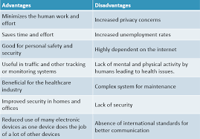
ADVANTAGES & DISADVANTAGES

Slide 18
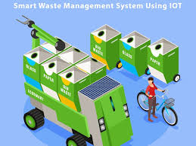
CONCLUSION
In conclusion, integrating IoT into smart waste management systems offers a transformative approach to urban ecology, enabling real-time monitoring, optimized collection routes, and reduced operational costs, ultimately leading to cleaner, healthier, and more sustainable cities.
The integration of IoT technologies within smart cities represents a transformative approach to addressing environmental challenges. Central to this transformation is smart waste management, which optimizes waste collection, enhances recycling efforts, and reduces urban pollution.

Slide 19
REFERENCES
The management of waste materials, usually based on the management of wastes at all stages (production, handling, storage transport, processing, and ultimate disposal) in such a way as to minimize the risks to human health, wildlife, and environmental systems.
IoT-Enabled Smart Waste Management Systems for Smart Cities"
(IEEE Xplore): This paper provides a comprehensive overview of IoT applications in smart waste management, including data collection, analysis, and route optimization.
"IoT based solid waste management system: A conceptual approach with an architectural solution as a smart city application"
(Bharadwaj et al., 2016): This paper explores the architectural design and conceptual approach of an IoT-based solid waste management system for smart cities.
"IoT-based framework for smart waste monitoring and control system: a case study for smart cities"
(Abba and Light, 2020): This paper presents a case study of an IoT-based framework for smart waste monitoring and control.

Slide 20


